Slide 1
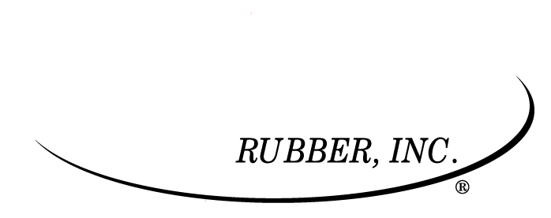
High-precision, custom molded rubber and plastic parts

Slide 2
Our single focus since 1960
Vast material knowledge
Third generation, family owned
Ability to take on challenging products
Our chemists alone have over 90 years of experience

Slide 3
Our Story
Started by Charles Daubenberger in 1960
He was working on airplanes for Lockheed Martin after WWII in California
Had the idea to develop a press with better control of process
Realized the better business model was the custom parts rather than the presses produced
Although modernized, custom presses are still the foundation of our business today

Slide 4
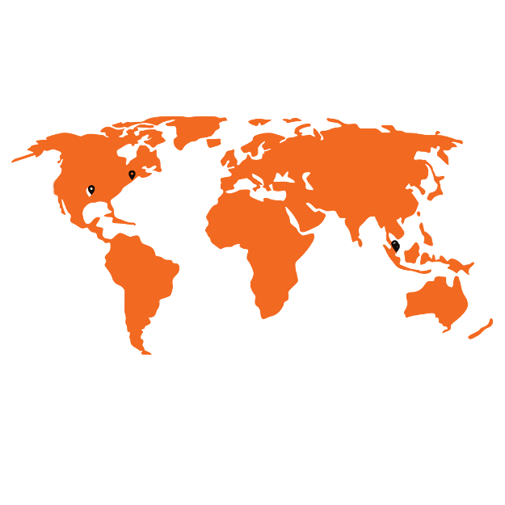
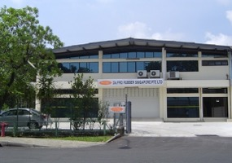
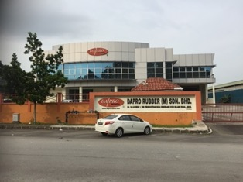
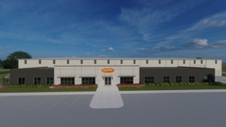
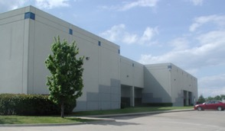
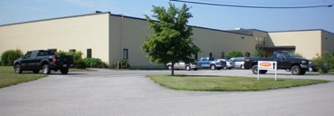
Supporting the world’s leading OEMs from multiple locations
Broken Arrow
Owasso
Newburyport
Jurong Town
Johor
OK, USA
MA, USA
Malaysia
OK, USA
Singapore
Headquarters

Slide 5
Broken Arrow, OK - Headquarters
New facility: 97,000 sq. ft on a 7-acre campus
Capabilities:
Custom Compounding
Over/Insert Molding
Compression Molding
Transfer Molding
Sub-Assembly
ISO 7 Cleanroom

Slide 6
Owasso, OK
Current facility: 45,000 sq. ft
Capabilities:
Custom Compounding
Liquid Injection Molding
Over/ Insert Molding
Compression Molding
Transfer Molding
Conductive Rubber
Sub-Assembly
ISO 8 Cleanroom

Slide 7
Newburyport, MA
Current facility: 36,700 sq. ft
Capabilities:
TPE Molding
Engineering Plastic Injection Molding
Commodity Plastic Injection Molding
Over/Insert Molding
Two-Shot Molding
Hot Stamping
Sub-Assembly

Slide 8
Juruong Town, Singapore
Current facility: 10,000 sq. ft
Acquired location in 1989
Capabilities:
Custom Compounding
Over/ Insert Molding
Liquid Injection Molding
Compression Molding
Transfer Molding
Sub-Assembly
ISO 8 Cleanroom

Slide 9
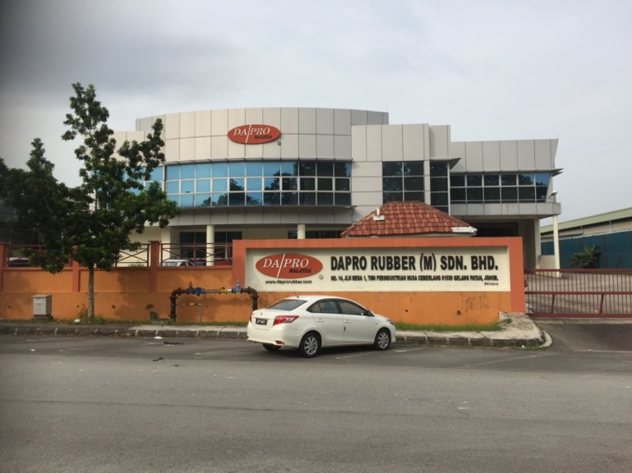
Johor, Malaysia
Current facility: 26,000 sq. ft
Capabilities:
Custom Compounding
Over/ Insert Molding
Compression Molding
Transfer Molding
Sub-Assembly

Slide 10
Our parts have been shipped to 50 countries — and outer space
An advantage of making small parts means we are not limited by shipping and logistics. The majority of our parts are sent by air.

Slide 11
Serving wherever there is a need for high-quality, precision parts

Slide 12
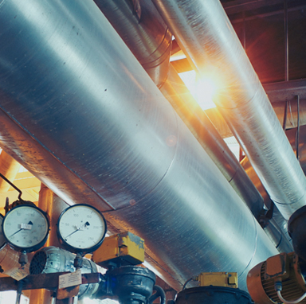
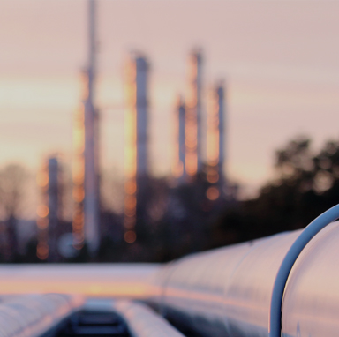
Medical
Aerospace
Electronics
Industrial
Oil & Gas
30% of our business
18% of our business
These three industries make up a wide range of the rest of our business

Slide 13
Capabilities

Slide 14
The Process
Our quoting and engineer team will take your design and help decide what they think is the best process requirement based on:
the configuration
what material you need
where you are going to use your product

Slide 15
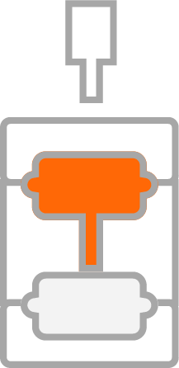
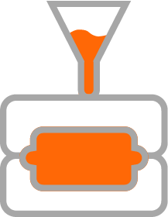
Rubber
Compression molding
Transfer molding
Injection molding
Micro molding

Slide 16
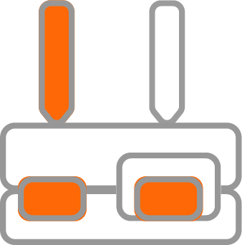
Plastic
Injection molding
Micro molding
Two-shot molding

Slide 17
The Da/Pro Difference
CUSTOM
COMPOUNDING
CUSTOM
MOLDS
CUSTOM
PRESSES
+
+
= PRECISION

Slide 18
Precision worth repeating
On-staff chemists to ensure you get the best compound for process and control
We provide in-house tooling or tooling with one of our third-party vendors that we have a close long-term relationships with
Our tight process control means high traceability and repeatability
We have high volume automated inspection machines built in-house by our engineering technical aptitude

Slide 19
Precision worth repeating
Class 10,000 (ISO Class 7) cleanroom
HEPA filtration
Pressure monitor
Airflow monitor

Slide 20
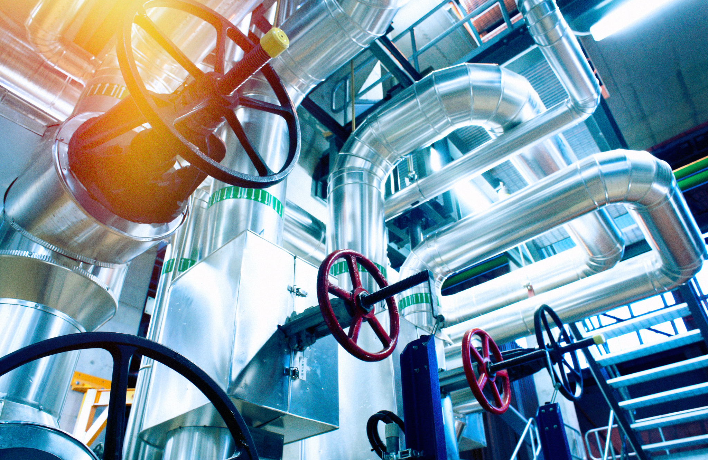
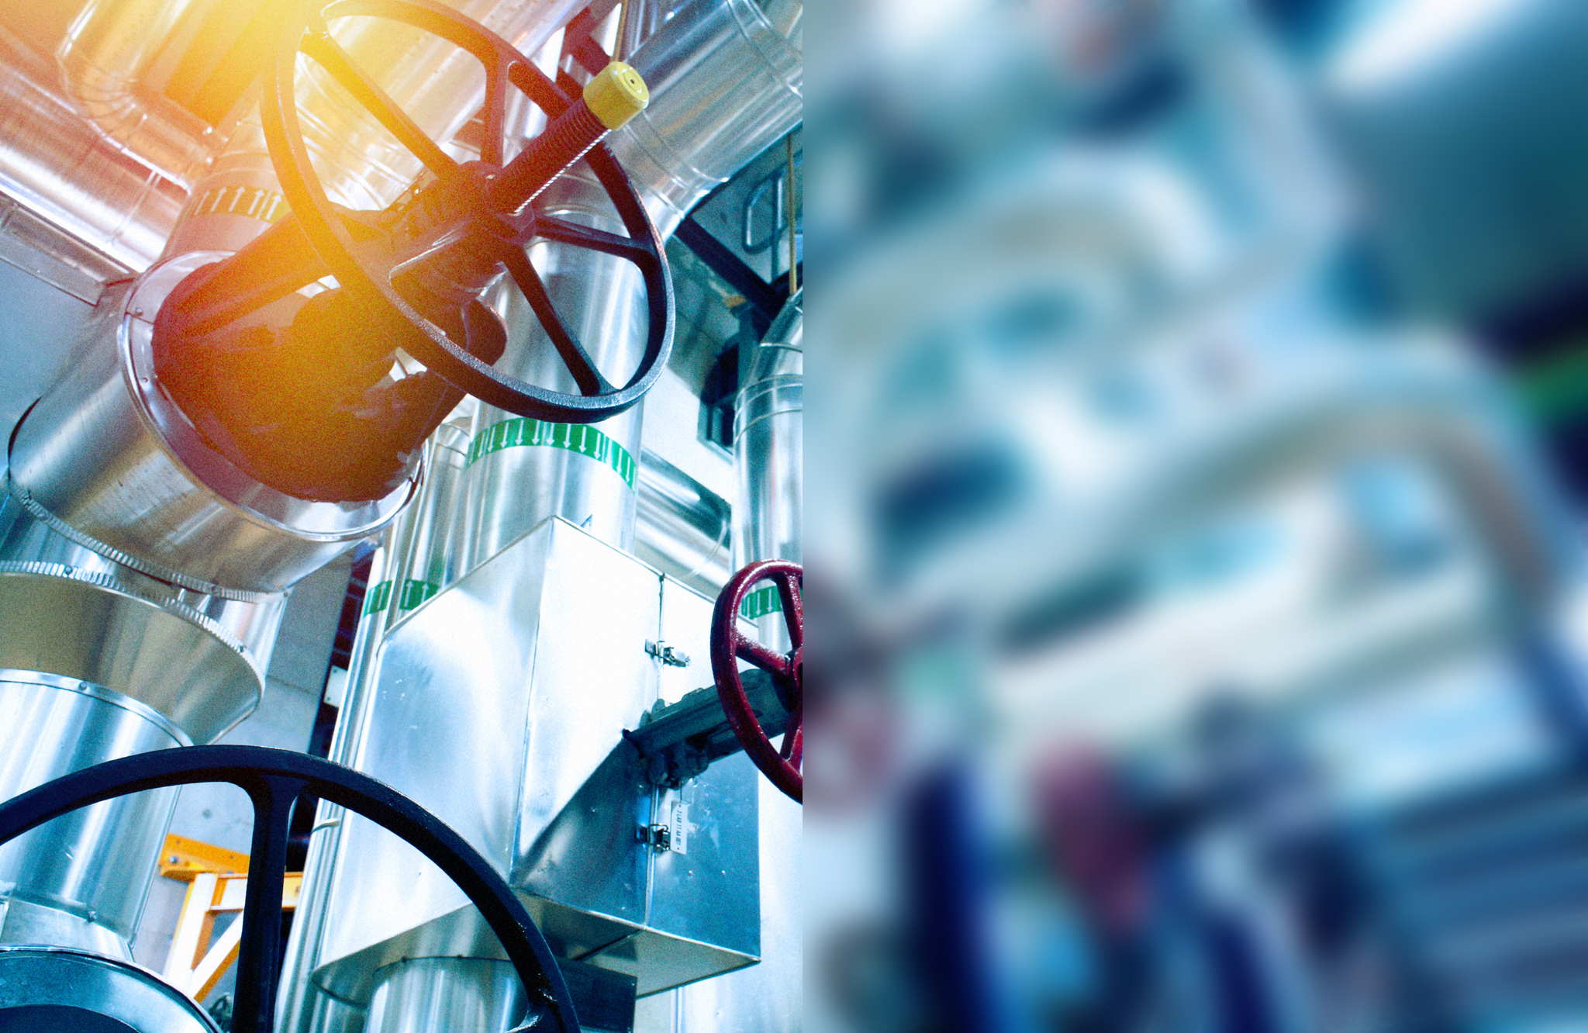
We do our part — so your parts can do theirs
Prototyping
Overmolding and bonding
Secondary processing
Chlorination
Deflashing
Parylene coating
Subassembly
Custom packaging
Inventory programs

Slide 21
We formulate quality
High precision/tight tolerances
Custom precision molds
Custom testing
Virtually flash free
Advanced Statistical Process Control

Slide 22
Certifications
ISO 9001:2015 Certification
Oklahoma Facility
Valencia, CA Facility
Singapore Facility
Massachusetts Facility – Plastics
Malaysia Facility
Meet standards and pursuing certification:
ISO 13485
AS9100

Slide 23
Sample of Rubber Compounds
Silicone
General purpose, high strength, Class VI, Phenyl,
fluorosilicone, Special grades, LSR
Urethane
Alloys
blends of various elastomers such as EPDM/Butyl,
Urethane/HNBR, Nitrile/Butyl/EPDM
EPDM
Neoprene (Chloroprene)
Nitrile- xnbr, hnbr, hxnbr
Natural/polyisoprene
SBR
Butyl- Chorobutyl, Bromobutyl
Fluorinated hydrocarbon
– Viton, Dyneon, Alfas, ffkm
Conductive Rubber

Slide 24
Sample of Plastic Compounds
TPE
Polypropylene
Polycarbonates
Ultem
Nylon
PEEK
Most commodity and Engineering plastics

Slide 25
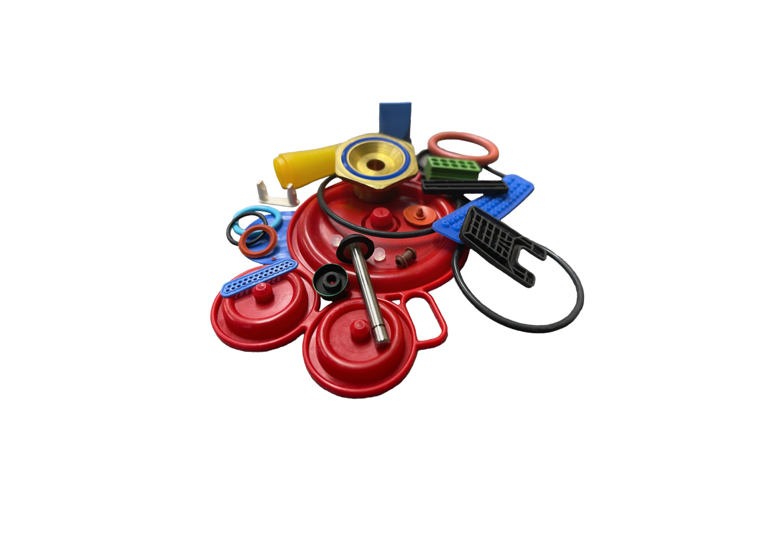
Sample molded parts
Diaphragms
Seals
Valves
Grommets
Conductive Rubber
O-rings
Gaskets
Connector inserts
EMI shields

Slide 26
Supporting the engineers who are changing the world

Slide 27
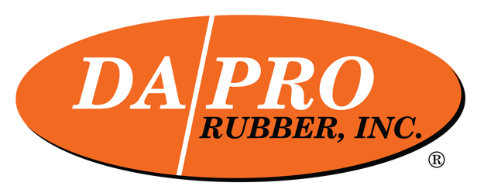
Thank you

